Slide 1
Streets Division Plowing Operations Hawk’s Landing
Winter 2016-17

Slide 2
Objectives
Outline City of Madison Streets Division’s response to snowfall events in Madison
Answer questions about our snowfall response procedures
However, we need you to hold questions to the end of the presentation - there’s a lot to cover

Slide 3
Common Concerns That Will be Addressed Later
Why some streets appear to receive more treatment than others
Why snow winds up in your driveway, and why that is unavoidable and unequivocally awful
And why some people get more snow in their driveways than others
Why some neighborhoods feel they are “always the last ones” to be plowed and why that is not necessarily true

Slide 4
Common Feeling We Can’t Address
Any problem that occurred in previous winters
We want to know when variances from our standards occur at the time the issue happens or immediately afterward so we can fix it - we can’t fix past issues.
As an example: “My street was missed in 2012!” Of course we don’t want that to happen. But we can’t help now because we won’t be able to figure out what happened or what conditions you witnessed, and if the street was actually missed or not. Past mistakes are not necessarily indicators of future failures if they are reported at the time.
Be a major league closer. Let’s be…

Slide 5
Let’s be Mariano Rivera
As the cliché goes, MLB closers have short memories so they can focus with the game at hand. Same goes for Madison winters. Whatever happened last winter, or the winter before – that game’s on the ledger & can’t be played again. But we can make this game, this winter, better.

Slide 6
DISCLAIMER!
Not all snowfall events are equal, and there is no one surefire response to every storm.
True, we can only plow it, sand it, salt it, or do nothing – but what is most effective depends on the storm, the wind, the temperature before the storm & after the storm, the available equipment and people, etc.
The responses described herein assume a “normal” snow with no complications.

Slide 7
Snow Response – Less than 3 inches on the Road
When snowfall begins to cover the road, 30 salt trucks are deployed to plow and maintain the salt routes. (16 trucks West; 14 trucks East)
Salt routes are the major thoroughfares in the city of Madison, Metro bus routes, roads around schools & hospitals, and some steep hills, curves, and intersection
Not school bus routes – too many of them
Sanding trucks also often deployed for hills, curves, and intersections – called “Sand First” routes. We typically have 2 of these trucks out (1 east; 1 west), giving us 32 crews.
On west side, there are 53 areas the Sand First truck has to service.

Slide 8
The red lines part of Salt Route 16. Blue lines are “deadhead” sections of Route 16. Hawk’s Landing is in the lower left corner. Red Tail/Lone Oak from Valley View to Midtown is the on salt route #16.

Slide 9
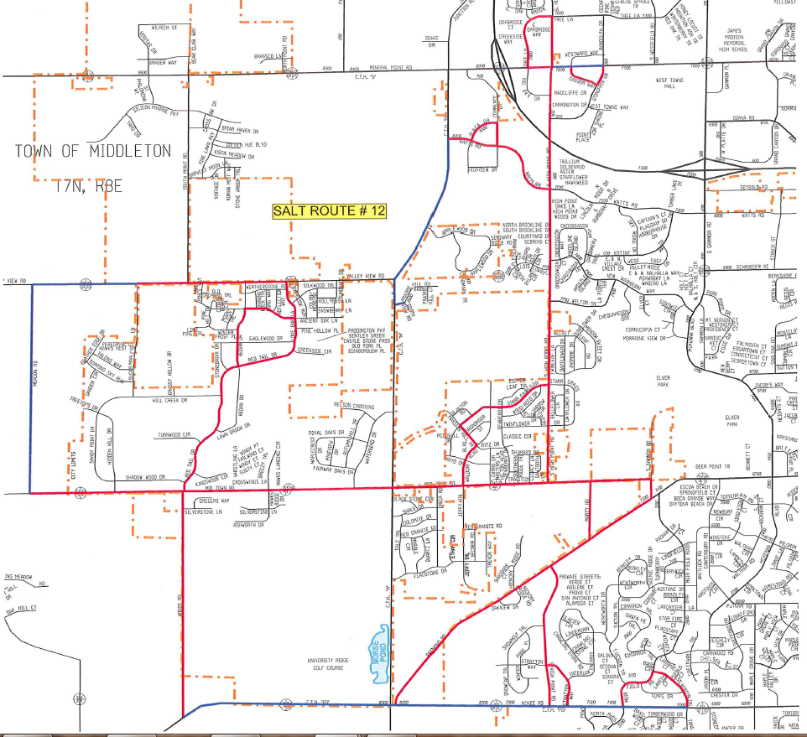
City salt route 12 also covers part of Hawks by servicing Lone Oak / Redtail from Valley View to Midtown, and also servicing Redan / Ancient Oak loop.

Slide 10
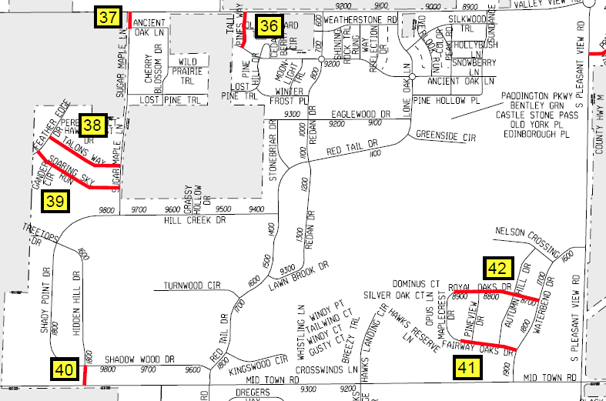
Sand first areas in the Hawk’s Landing vicinity

Slide 11
Areas covered by city salt routes & sand first in Hawk’s Landing
County Highway M (Pleasant View) is handled by the Dane County in your neighborhood
Red is salt route
Blue is sand first

Slide 12
Snow Response – Salt Routes
Salt routes are maintained 24 hours a day when needed as determined by Streets Division operations staff
If it snows and covers the road, salt route crews will be out and crews will remain out until they are no longer needed
Salt deployed at a rate of 300 pounds per 2-lane mile
These are the only roads in the city that receive a salt treatment
Only works at the volume we use when it is over 15 degrees
If under 15 degrees? We only use sand.

Slide 13
Snow Response – Brining
On select major thoroughfares, if weather conditions allow, a saltwater brine is applied 24 to 48 hours prior to the event
Brine helps keep snow from binding to the pavement and allows us to use less salt overall
Not in Hawk’s Landing
Yet…we lack the equipment and time to brine everywhere we would like to.
Brine is 23.3% salt
Brine also used when salt is spread in order to keep the salt on the crown of the roads.

Slide 14
Snow Response – Area Sanders
For residential streets that are not serviced by a salt route, after the snow, patrol trucks called “Area Sanders” are deployed to apply sand to hills, curves, intersections, and areas of reported slippery spots.
Depending on conditions, there can be anywhere between 5 and 10 sanding trucks deployed for the entire west side of Madison

Slide 15
Snow response is more than just streets
Crosswalks
Bus stops
City sidewalks
Bike lanes (and some paths)
City Engineering and Parks plow most of the off-street paths
Snow hauling (when needed)
Cleaning trucks (to prevent rusting)
Alley & carriage lane plowing
Vision hazard removal
Receiving salt & sand

Slide 16
Snow Response Over Three Inches on the Roads
When three inches or more of snow has accumulated on the roadway, a General Plow will likely be declared
Both General Plows and Snow Emergencies mean the same thing for your neighborhood
Alternate side parking tickets increase to $60 during snow emergencies is only difference felt here
All residential streets will be plowed

Slide 17
Where do we measure the snow?
There are different locations on residential streets on both sides of Madison that field staff test the snow depth on the roads.
Often use dead ends since there’s less traffic
Routinely, some areas of the city receive more snow than others, but we can’t plow only part of the city.
For example, we could never plow Cardinal Glen because they had 3 inches but not Hawk’s because they had 2.5.
We have to make a judgment call if the snow is deep enough throughout the city to plow everyone

Slide 18
In depth snow depth
The key words here are “on the road.”
Official snow depths reported by the news are not the same thing as snow on the roads.
Official snow depths on the news are captured by laying a piece of plywood out in a grassy area with a snow gauge on top
Official snow depth does not account for the melting of snow caused by warmer road temperatures
Also, consider neighborhood geography

Slide 19
Time out, buckaroo! What about the winter of 2015-2016! We got 5 inches of snow just before Thanksgiving and nobody plowed. That was over three inches. What gives, bub?
Remember – be a closer…be like Mariano Rivera…

Slide 20
Time out - Explained
Decisions are not made in a vacuum but in a continuum
Related predicted weather events may affect how we need to respond to a given storm
If we get three inches of snow on the road, but it will be 60 degrees the next day, why spend a quarter million of taxpayer dollars on plowing something that will melt quickly?
We are stewards of resources – both financial and environmental - plus tasked with keeping the roads safe so the city can function. It is a constant balancing act.

Slide 21
Snow Response – General Plowing
When a general plow is called, crews begin plowing when the snow has ended or near the end of the storm
Otherwise, we’d just have to plow them all again, doubling the workload & cost
We try to plow overnight so there’s less traffic, but the storms don’t always cooperate.
Sometimes Madison can go to bed with it snowing and wake with roads clear – but cannot always happen.

Slide 22
General Plowing –Bodies & Trucks
Over 150* pieces of equipment are deployed during general plows this includes equipment from
Streets Division
Parks Department
Engineering
Contractors
*Actual number of pieces of equipment varies by what & who are available at the time of the storm

Slide 23
General Plowing – The Goal
General plows take 10 to 12 hours to complete.
The goal is to make all the streets in the city accessible.
This means getting the snow out of the street.
With alternate side parking rules, we hope to clear at least one side of every street all the way to the curb.
General plows end when each street has been plowed.
After the general plow, crews are assigned to salt routes, sand first routes, and area sanding
Area sanders focus on residentials area that are in need of attention and apply sand to slippery spots
Salt routes trucks & sand first cover their assigned routes
Finally, another shift is needed to come in at midnight the night after a general plow to plow the side of the street we were not able to get due to alternate side parking

Slide 24
Plow timeline example (this assumes ideal conditions with no complications, of course)
12pm – 9pm Sunday: Snow! Over three inches accumulates
9pm – Sunday: Snow stops. General plow begins
7am – Monday: Plow complete & crews transition to salt routes & area sanding (other Streets services performed starting now as well)
3pm – Monday: Salt routes maintained through evening rush
12am – Tuesday: Alternate side parking plowing
7am – Tuesday: Area sanders and plow backs
3pm – Tuesday: Everything back to winter normal.

Slide 25
What needs to be plowed

Slide 26
Mile Plowing – Citywide
In the city of Madison, there are 1,793 lane miles to plow.
What is a “lane mile”?
A lane mile is a mile of each lane of traffic.
Imagine a 1-mile long stretch of a 4-lane road. That piece contains 4 lane miles and we have to plow each lane.

Slide 27
Mile Plowing - Citywide
Plowing 1,793 lane miles is the equivalent of plowing from Madison to the Mojave Desert

Slide 28
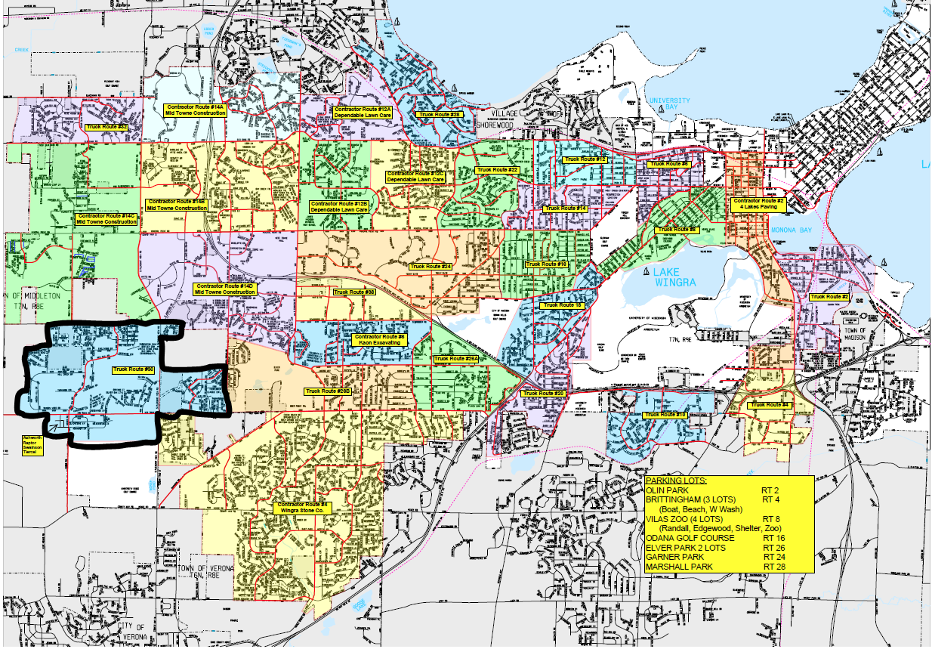
West side general plow zones of responsibility

Slide 29
General Plow: There Is No “Last One to Be Plowed”
The west side is divided into 32 different plow zones that the Streets Division, Engineering, Parks Construction, and private contractors follow.
All 32 zones have multiple pieces of equipment assigned to each, and all begin their shift at the same time.
As crews complete their assigned zones, they are moved into a new zone to help plow.
Each piece of equipment in the zone has a starting point that makes the most sense for us, and an end point that makes the most sense
The goal is remove the snow from the street as efficiently as possible. Changing start and end points for each snow event out of a sense of fairness will not help us get the snow out of the street faster.

Slide 30
But there are priorities…
Major thoroughfares are done first
More people rely on them, including emergency management.
Arterials and secondaries
Cul-de-sacs and dead ends
Because of their tight turns, most need to be plowed by something different than a standard plow truck that handles the through streets, so they take longer to get to
Carriage lanes, bus pads, etc.

Slide 31
About Hawk’s Landing… Travel time – about 30 minutes

Slide 32
Travel time - continued
For example, if a general plow is declared to start at 9pm crews start at 1501 W. Badger Rd.
They get their zones/routes assignment, perform safety checks on their vehicle, get fuel, & load salt or sand. This could take 30 minutes.
Add travel time.
Crews may not begin plowing in your neighborhood until 10pm (doesn’t consider mechanical issues).
We would like it to be faster, too – but you’re far away from where we are

Slide 33
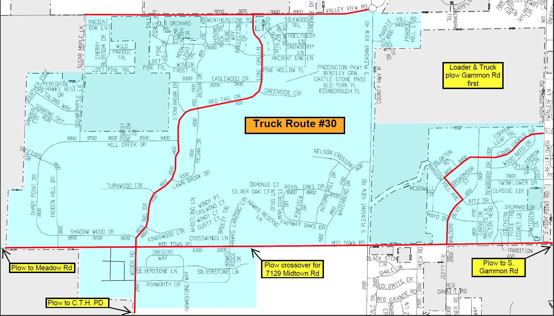
Hawk’s Landing Lane Miles?
The blue area below is about 51 lane miles. (That’s about the distance Madison to Mineral Point, WI).
City crews handled your neighborhood, not contractors.

Slide 34
And there’s the carriage lanes…
Plowed on a separate route by a separate vehicle.
Deployed at same time as other plow trucks.
This route has 20 separate sections of sidewalks & carriage lanes to plow throughout west side

Slide 35
Time out! So, you’re saying that if I live in a cul-de-sac on the far west side of town, and it takes you an hour just to get to my neighborhood, and then I have to wait even longer for the special truck to plow it – doesn’t that make me last?
Given the circumstances of where you are in Madison and where your home is, you are plowed as efficiently as we can muster.
This isn’t an operational choice. This is the limitation of what is possible.
Last? Probably not. Takes a while? Probably true.
Many neighborhoods throughout Madison feel they are last – plowing takes a lot of time.

Slide 36
Equipment used in your zone: Plow truck

Slide 37
Equipment used in your zone: Loader

Slide 38
Equipment used in your zone: Grader

Slide 39
Equipment used in your zone: One ton truck

Slide 40
How We Plow – Residential Streets
First priority is to make the street accessible to users
Centers cut
Curb cuts, or plowing back to the curb, happens next
It can take 3 passes on some residential streets to get the snow all the way out of the street
Centers and then two curb cuts

Slide 41
How We Plow – Culs-de-Sac
Each one is different depending on how tight the turns in the dead-end, how much frontage is in the dead-end, if there is an island, and if there are parked cars.
Goal still the same – get the snow out of the street so everyone can use it.
Loaders are often used in cul-de-sacs because of their articulated mid-section, and they can make the turns betters than a plow truck.
Basic method: push snow from the bulb to the curb and then plow the curb line.

Slide 42
How we plow – Carriage Lanes
One-ton truck can plow these on one pass
Sometimes an additional clean up/widening is needed later
Not the highest priority for deployment for plow shifts
We have to be sure plowing the streets is fully staffed before we assign people to alley/carriage lane plowing
Sometimes can lead to delays

Slide 43
What plowed looks like on residential streets…
Do not have a bare pavement policy. (Would require significant salt use.)
Picture taken on my street around 4:45pm on December 12 (after December 11-12 plow)

Slide 44
A Note about Hard Pack & Fluff
Hard pack on streets is normal after a plow
Plows don’t push down, they push out and to the side, and that creates a layer of tightly compacted snow
Graders push down, but hard pack may develop still
One grader in west side fleet
Warmer temperatures cause the hard pack to release from the pavement and fluff up
Gives the appearance that the street was not plowed because ruts form and roads looks snowy
When this happens, we plow the fluff (like we did on 12/22)

Slide 45
Why is there snow in my driveway?
Gravity.
Plow blades are angled to push snow from the street to the curb – it’s the only way to get the snow out of the street.
Snow gets pinned to the plow blade by the curb line, and the snow piled on the terrace
Driveway aprons create a cavity along the curb.
Snow pinned against the plow will naturally fall off into that driveway apron cavity

Slide 46
A quick lesson in driveways
Or how to choose a house that won’t get as much snow in the driveway

Slide 47
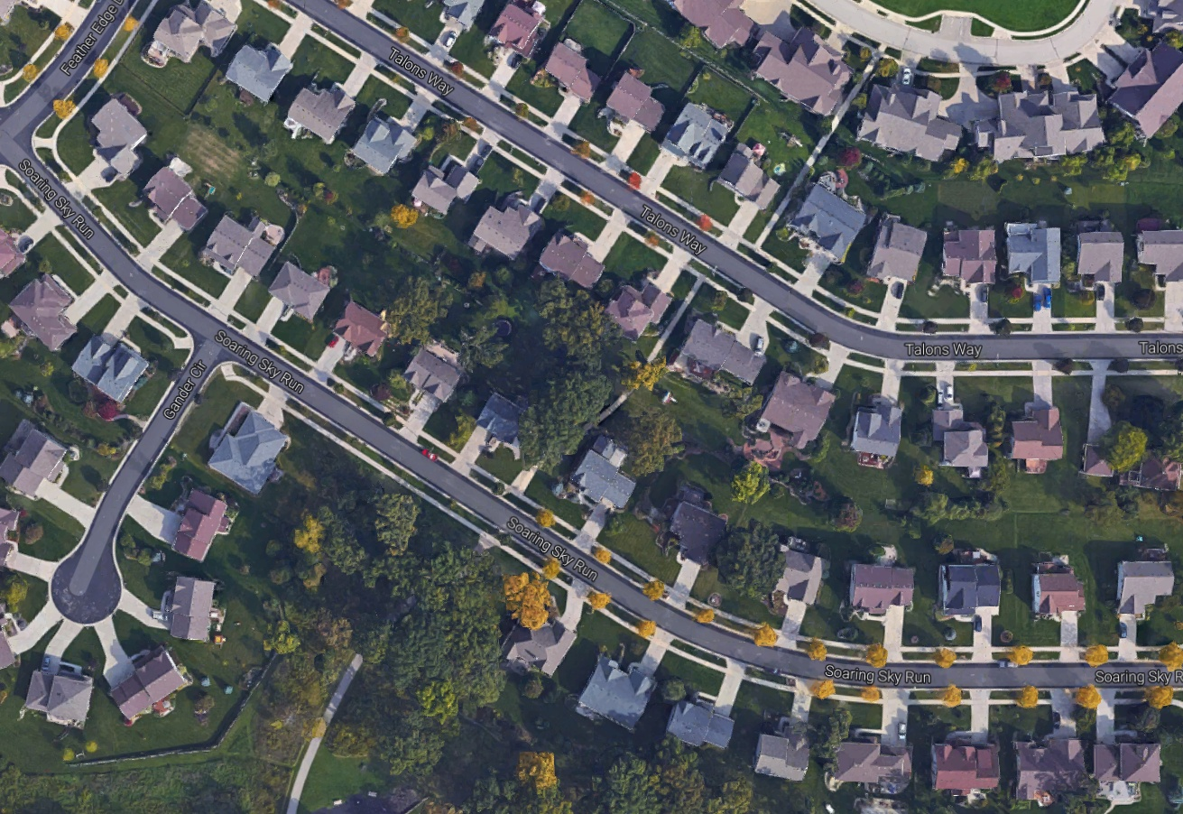
Here is a Google Earth snapshot of Soaring Sky & Talons Way. Notice the driveway aprons on Soaring Sky, and notice how many there are.

Slide 48
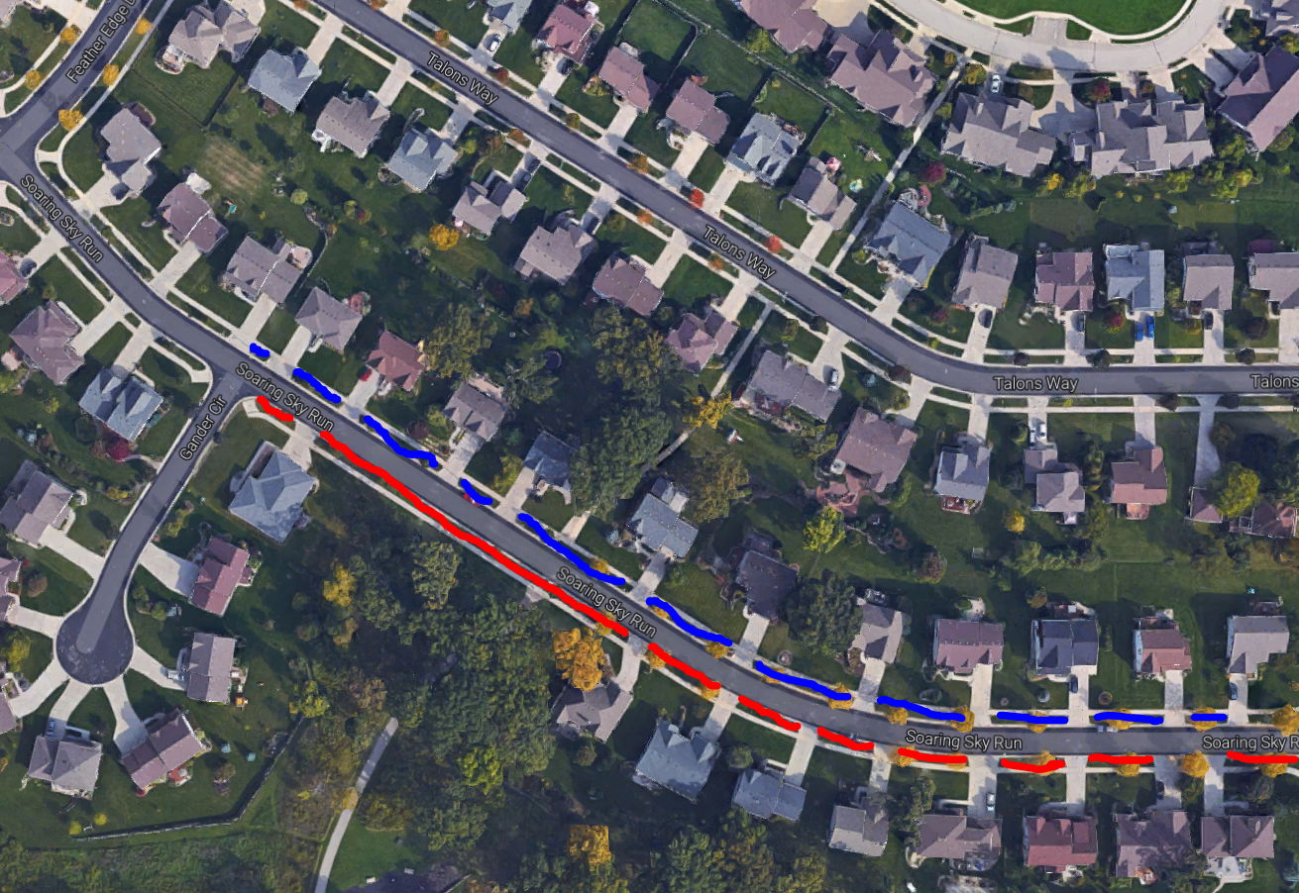
Now, see the distance between each driveway. We plow in the direction of travel of the road usually. Below, the blue lines are plowed east to west. Red lines west to east.

Slide 49
The lines represent how much distance the plows gather snow before the snow falls off the plow blade into a driveway. Who do you think gets the most snow?

Slide 50
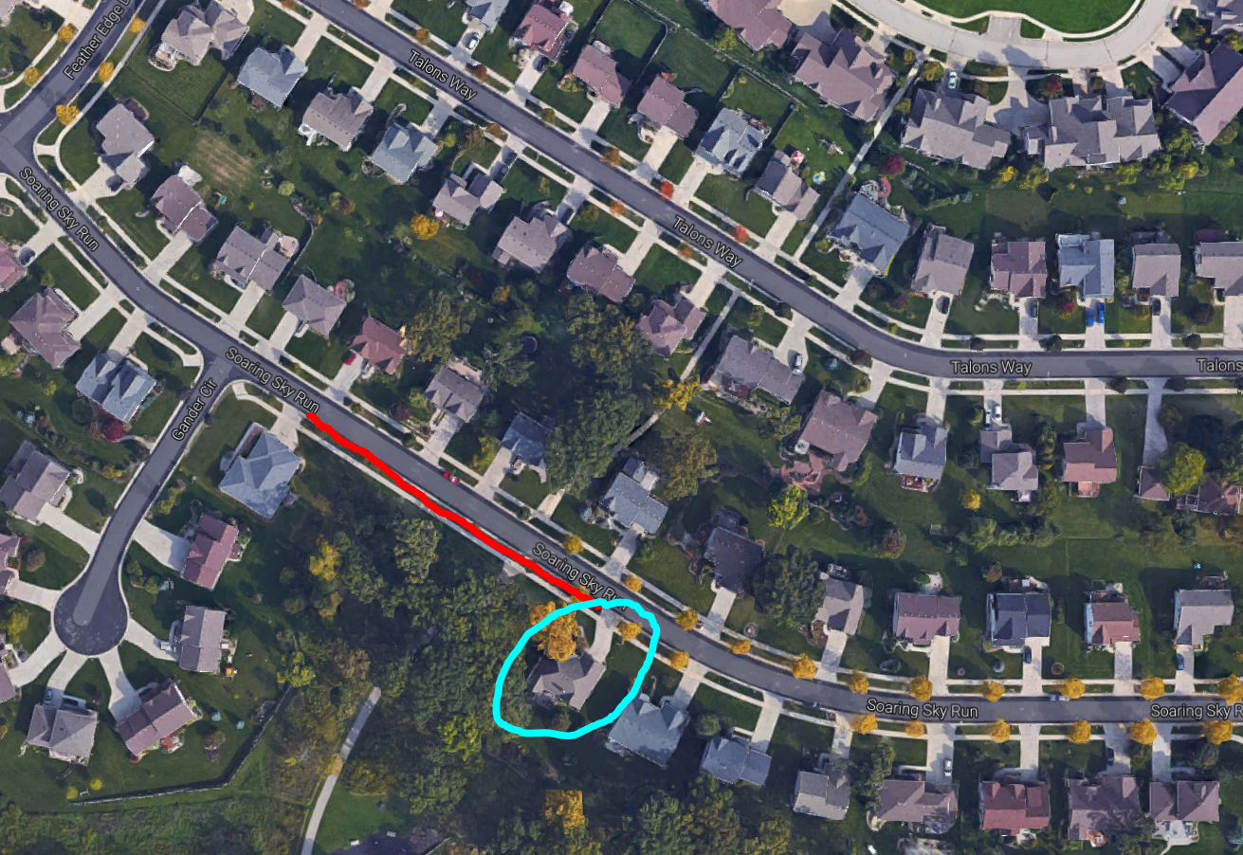
This house probably gets more snow than the neighbors. In fact, that whole “red” side of the street might have more snow in the driveways because there are fewer off-loading opportunities (aka driveways).

Slide 51
Snow in the driveway
It is not malicious.
It is not intentional.
It is an inconvenience.
It is a huge pain in the neck (and back). (But it could be a cross-fit exercise?)
It is a problem for everyone with a driveway.
It is unavoidable.

Slide 52
And bad contractors can make the problem worse
Contractors clearing driveways should NEVER push snow across the street.
They should push it into your yard.
It’s an ordinance violation.
Plus when they do, the plows grab snow from the street, plus the extra pile the contractor pushed out.

Slide 53
Bad job by a driveway contractor…
See the driveway up the road from the truck on the right hand side? They’re getting extra snow because of this contractor piled it on the curb line.

Slide 54
Why is snow in the driveway unavoidable?
There’s nowhere else for the snow to go.
Trying to get the snow out of the street so it is safe for all roadway users

Slide 55
Preventing driveway snow: What about changing the plow blade angle?
Still would get snow in the driveway & would create a new problem of windrows in the street
Goal is to get snow out of the street after all

Slide 56
Preventing driveway snow: What about a mechanical solution?
Other communities try this (Sioux Falls, SD)
They use a mechanical arm that chops down and blocks some snow from falling into driveway. Operator lowers the arm for each driveway and raises it when they get beyond it.
Doesn’t work with snowfall over 5 inches – the snow goes over the arm
Creates narrower streets – the arm prevents getting close to the curb
Creates new problem of snow build up at edges of driveway – drainage issues
Requires different equipment & would increase cost (to buy new equipment and for maintenance of the arm)
Greatly increases plowing time
And, it only “minimizes” the amount of snow in the driveway.

Slide 57
Time out! So, there’s nothing I can do about snow in the driveway? I don’t agree. I think there’s something.
One thing to do would be to wait to clear your driveway apron until after the streets have been fully plowed – if possible. May minimize the amount in your drive.
We’re open to suggestions. If other means are known that can remove snow from the street efficiently both in cost and time, while not filling the aprons & not creating new hazards, let us know. (Canadian method of blowing snow into front yards probably not an option.)
Snow is an absolute inconvenience for our expectations.

Slide 58
Time out again! Why can’t the city shovel out my driveway?
We would need to shovel out every apron in the City.
Over 70,000 homes in the city of Madison
Does not includes businesses, apartment buildings, condos, or churches - all of which would need to be shoveled out by city crews, too.
It would never get done before the next storm
And we would need dozens and dozens of people to do it

Slide 59
Special note: December 15
West side Streets Division ran a training exercise with the grader in your neighborhood.
The normal layer post-plow hard pack on the street was peeled up & crews removed the mess of snow this project created
West side has 1 grader and it is the only piece of equipment in the fleet that can provide down force to break hard pack from the road
Not enough people, time, or equipment to do this city wide for every storm

Slide 60
Stay informed
Visit www.cityofmadison.com/winter
Sign up for Snow Plow Updates
Sign up for Snow Emergency Updates
Maybe even sign up for text updates for snow emergencies
Sign up for Sidewalk Clearing alerts
This is from Building Inspection – not Streets

Slide 61
Questions?
Call Streets Division - West:
608-266-4681
Email:
streets@cityofmadison.com

Slide 62
2016-17 Winter Diary
December 4 event:
All forecasts called for 1-3 inches until snow began to fall on Sunday and totals kept increasing. Road temperatures were high, and a lot melted, but it was a heavy, dense snow. Drivers created deep ruts in snow, so decision made to plow because if temperatures dropped the ruts would freeze and could not be cleared. Salt routes were maintained throughout storm until general plow began around 10pm 12/4. Plowing operation ended by 6am, 12/5 (9 hours). Available staff prevented some alleys from being plowed immediately. This snow was very dense, so shoveling driveways was pretty tough for a lot of people. Official snow depth: 5.7 inches, new Madison record for the day. Snow on the roads? Deep enough.

Slide 63
2016-2017 Winter Diary
December 10-11 event:
All forecasts prior to event predicted up to 12 inches of snow – some saying snow would start Saturday and not end until Sunday evening. Road temperatures below freezing, so all the snow will stick. Since pavement was dry, select streets were brined before snow event on 12/9. Snow started falling Saturday around 3pm and continued until close to 7pm on Sunday, giving us over 7 inches on the ground – plenty deep enough for a general plow. A snow emergency was declared. No staffing issues and a general plow commenced around 10pm 12/11. We received a light snow overnight during plowing. Another complication: since this was such a powdery snow it drifted in some areas with the moderate winds (especially on far west side where it is more open). Plow finished by 6am 12/12 (9 hours). Clean up operations post-plow were continuous until 7am 12/13.

Slide 64
2016-2017 Winter Diary
December 16-17 event
All forecasts called for another deep snow, 7 to 10 inches, plus polar vortex temperatures that render salt ineffective. Roads will be slippery as only sand applied to help with traction. Snows started around 3am Friday. Snows stopped Saturday morning with just north of 3 inches on the ground. We elected not to plow at that time because another band of snow was coming and when it did, it dumped another 4 inches on the road. Plowing started around 9pm on 12/16 and wrapped up around 7am on 12/17. With more snow piled on the terraces, roads get narrower and requires more touch up as snow falls from the curb windrow into the street (harder to push the snow out of the street when the windrows are piled high on the curb). Worked on plow back operations throughout the whole week, and plowed off the fluffed hard pack on 12/22.

Slide 65
2016-2017 Winter Diary
December 23 & 25 events
12/23: Snow predictions ranged from just over 1 inch up to 4 inches. Snow came much later than anticipated on 12/23, but salt route crews were out since 7am on 12/23. Salt routes maintained throughout the storm and into the over night hours. We ultimately received less than the 3 inches on the roads, so no general plow needed.
12/25: Freezing rain event predicted initially then removed from forecasts. Even forecasts received in the evening on 12/24 said no freezing rain. Then we received freezing rain on 12/25. Crews were dispatched to the salt routes and maintained these routes until weather warmed in the afternoon.

